Slide 1

TrackMate Pro
A Next.js and MongoDB-powered platform designed to streamline student project workflows
Presented by: Yash Baldaniya
Kartik Guleria
Role: Yash Baldaniya → UI Design (Frontend)
Kartik Guleria → Backend

Slide 2

Project Overview
Our web-based platform simplifies college project management with distinct access for different stakeholders:
Students
Create projects, form teams, submit weekly progress
Faculty
Guide projects, review submissions, provide feedback
HOD
Oversee department projects, assign guides, track overall progress
Admin
System maintenance, user management

Slide 3
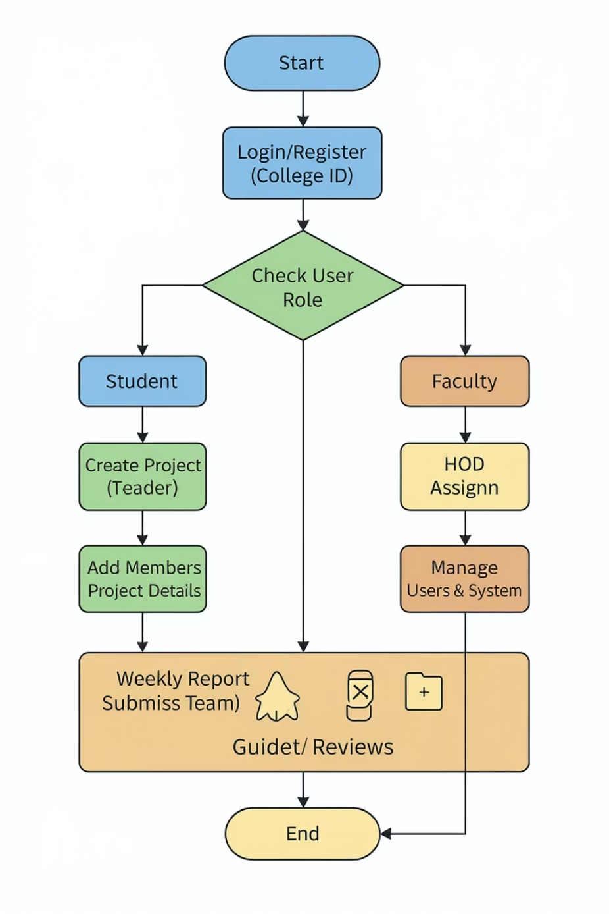
Flowchart

Slide 4



Tools & Technologies
Our technology stack combines modern frameworks for optimal performance and development efficiency
Frontend
Backend
Next.js React framework providing server-side rendering and intuitive routing for a responsive user experience
Node.js with Express framework handling API endpoints, authentication, and business logic
Database
Version Control
MongoDB Compass for flexible document-based storage, visual data exploration, and efficient querying of project information
GitHub for collaborative development, code reviews, issue tracking, and maintaining development history

Slide 5
Week-by-Week Frontend Progress
Week 1: Planning & Setup
Week 3: Project Creation Interface
Collaborated on project structure planning
Built Create Project Page with form validation
Established division of responsibilities
Designed project description text editor
Set up basic Next.js project architecture
Implemented Add Members interface with search
Created component library foundations
Created team role assignment components
1
2
3
4
Week 2: Dashboard Development
Week 4: Reporting & Refinement
Designed Student Dashboard UI with navigation
Developed Weekly Report Submission Page
Implemented responsive layout grid system
Improved responsive design for mobile devices
Created project section navigation components
Enhanced accessibility features
Established consistent styling patterns
Polished UI transitions and interactions

Slide 6
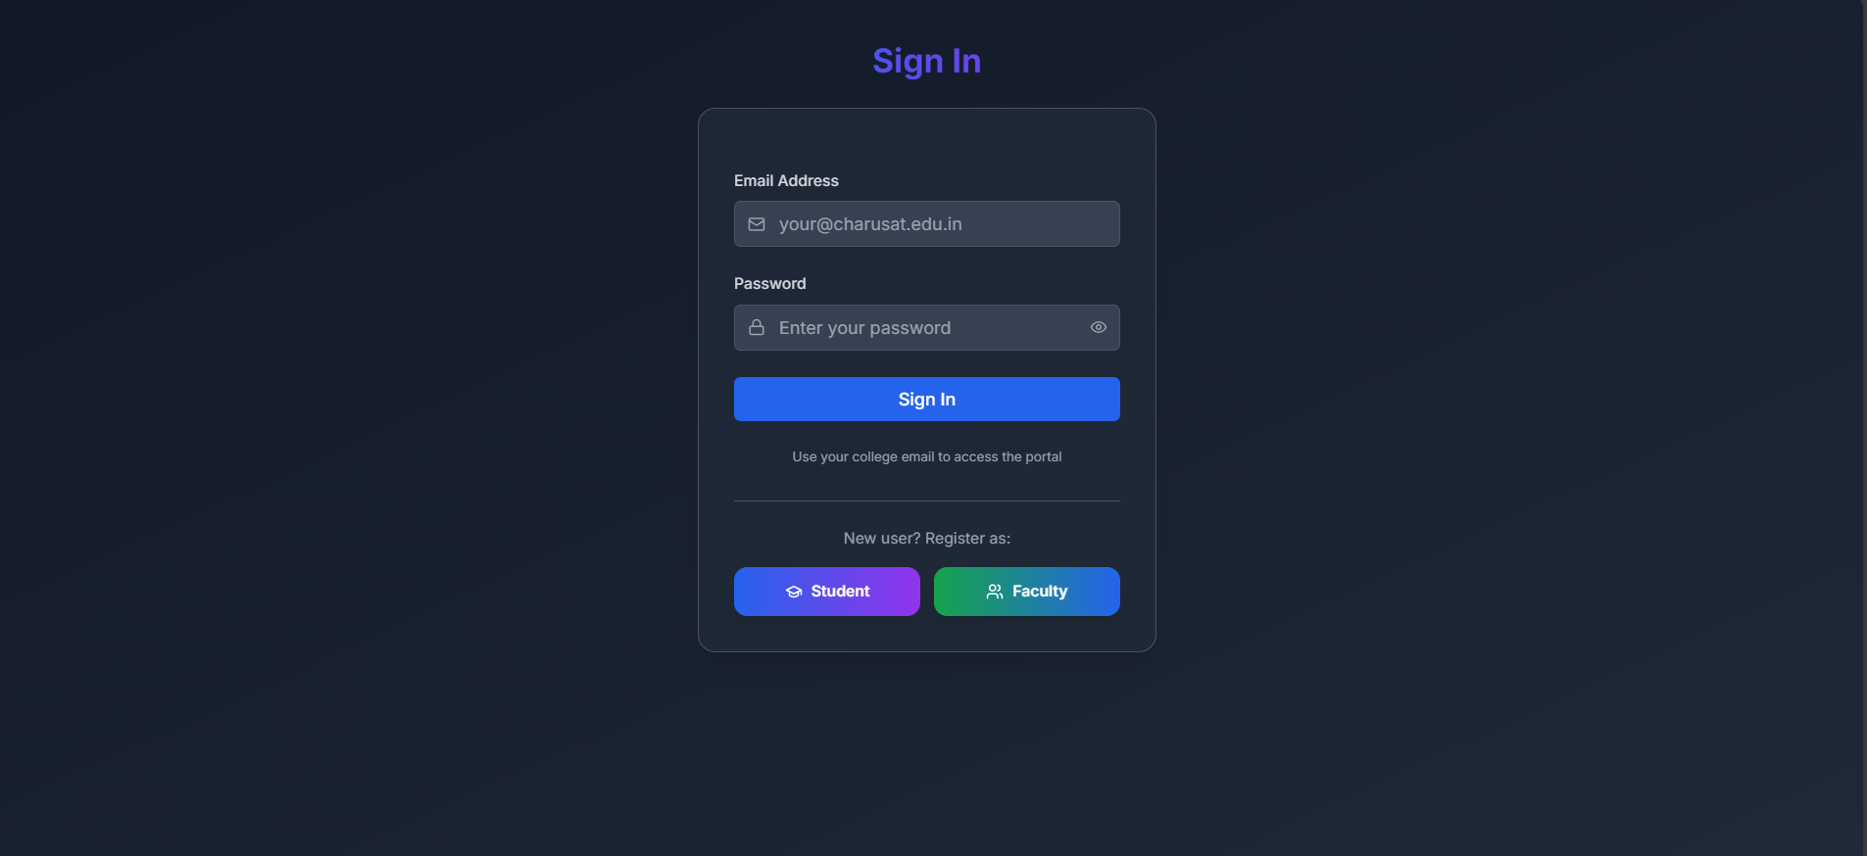
UI Screenshots
SIGNUP and LOGIN page
Each interface was designed with consistency, usability, and responsive behavior as primary considerations

Slide 7
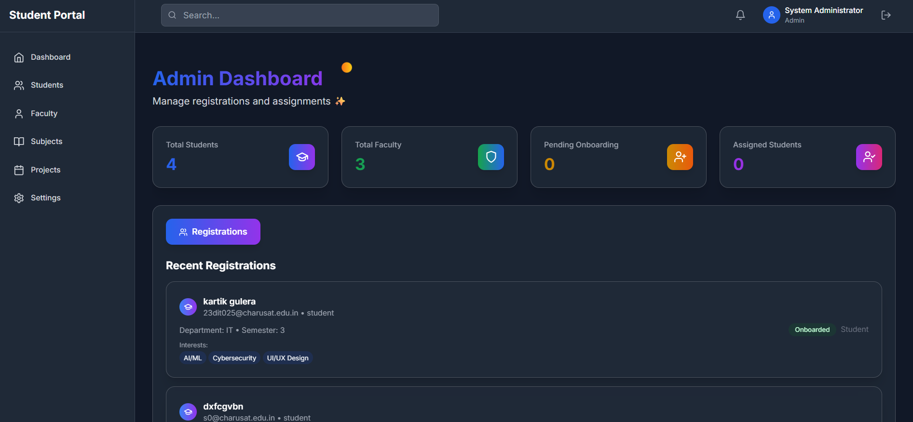
UI Screenshots
ADMIN DASHBOARD
Each interface was designed with consistency, usability, and responsive behavior as primary considerations

Slide 8
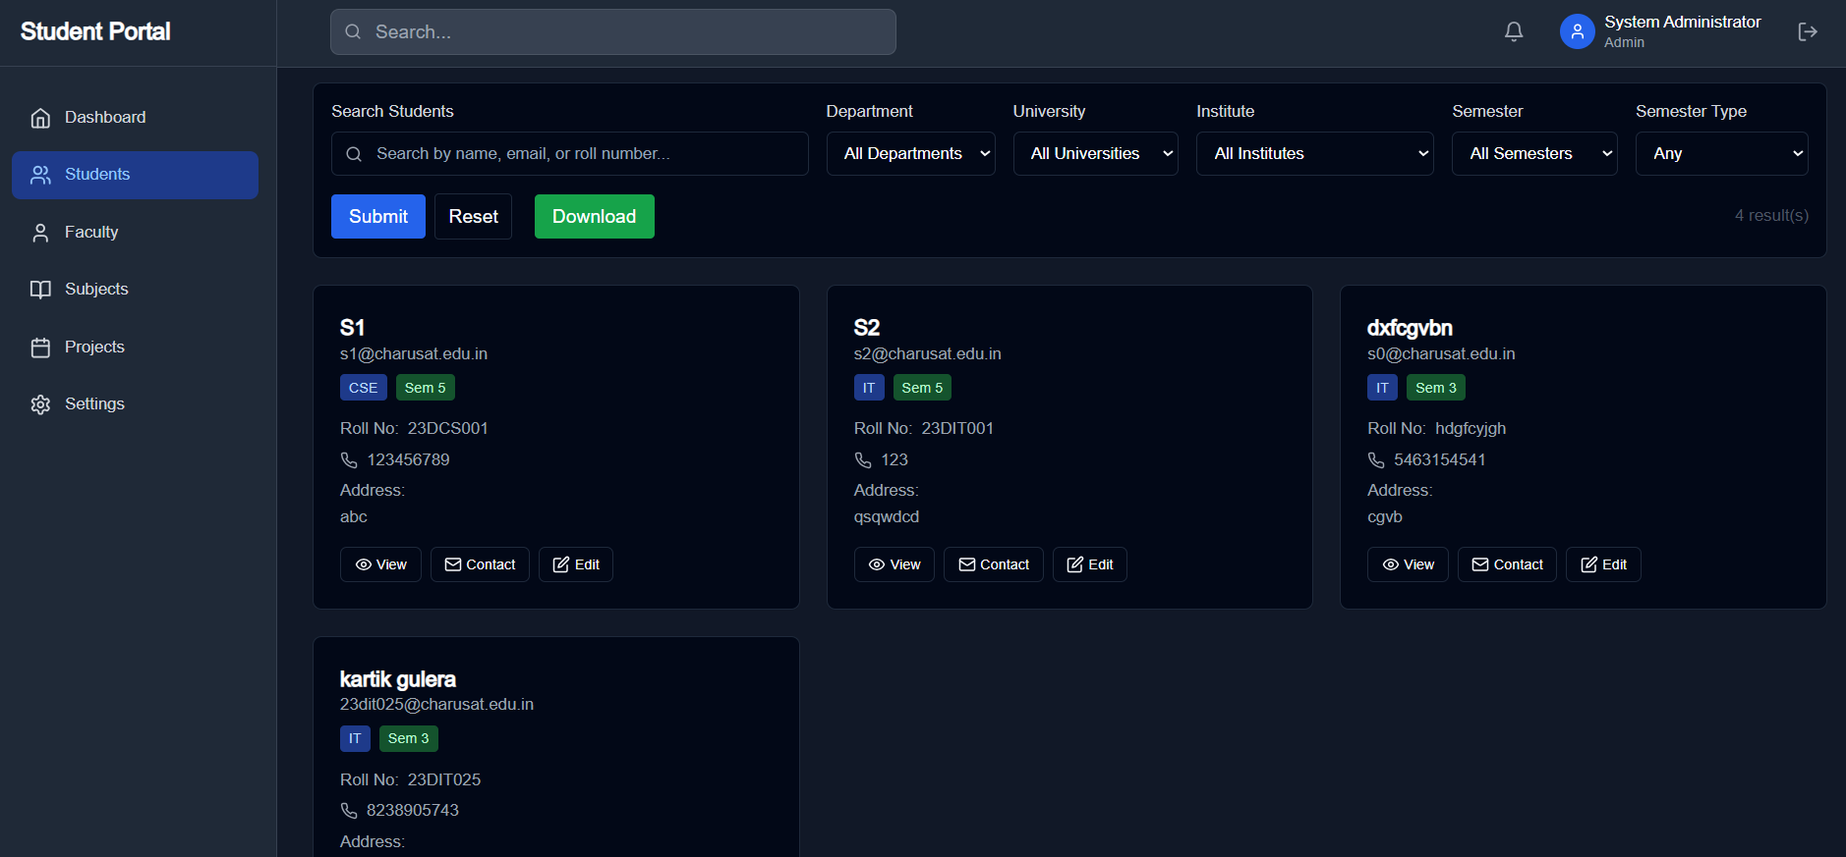
UI Screenshots
STUDENT PAGE FOR ADMIN ROLE
Each interface was designed with consistency, usability, and responsive behavior as primary considerations

Slide 9
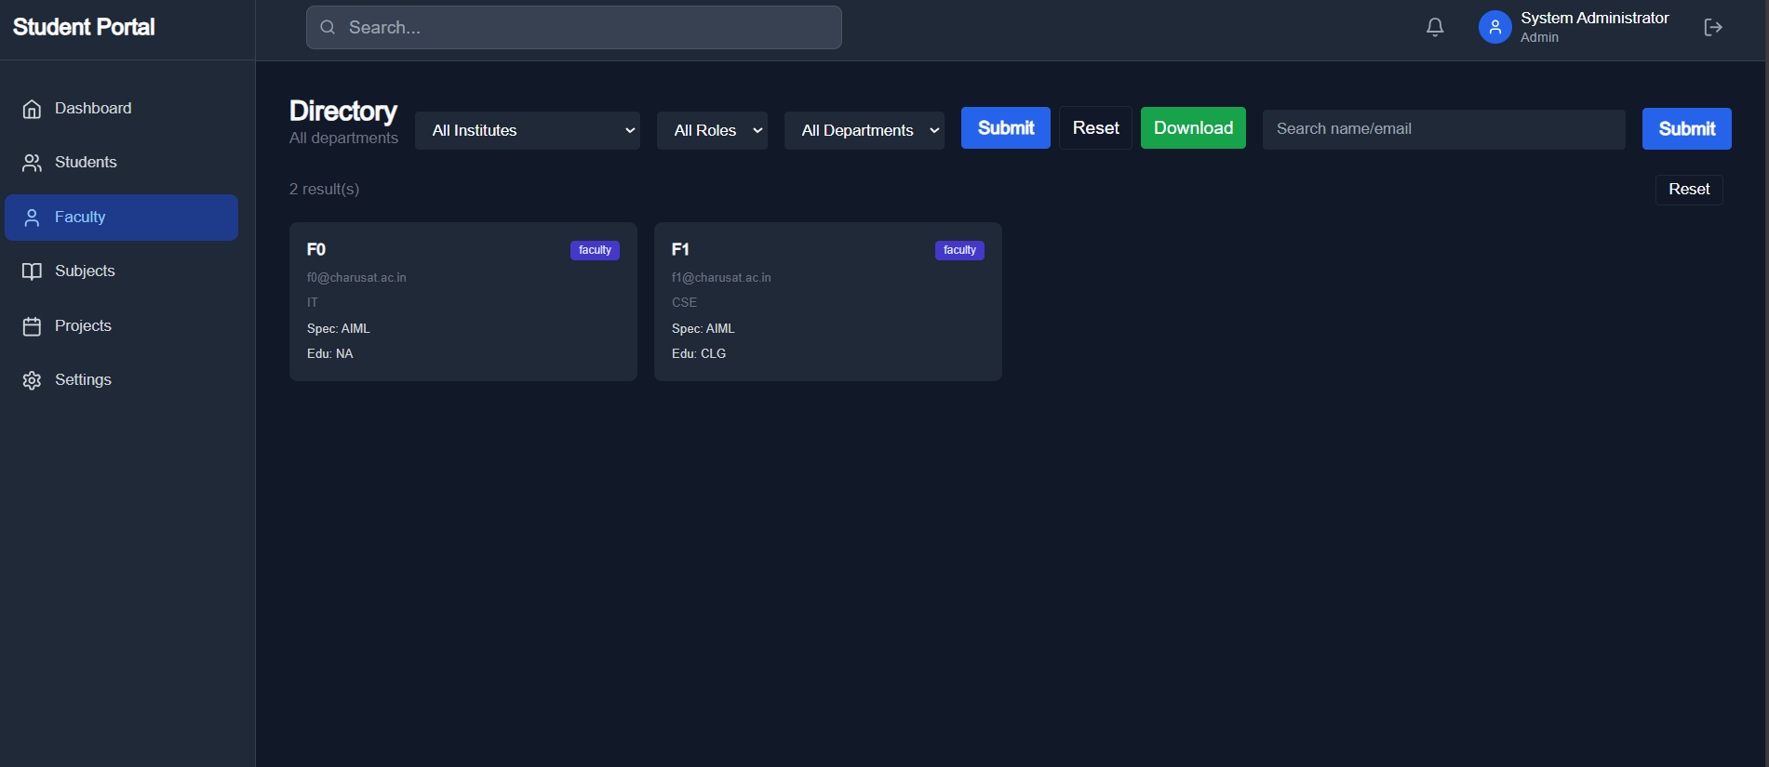
UI Screenshots
FACULTY PAGE FOR ADMIN
ROLE
Each interface was designed with consistency, usability, and responsive behavior as primary considerations

Slide 10
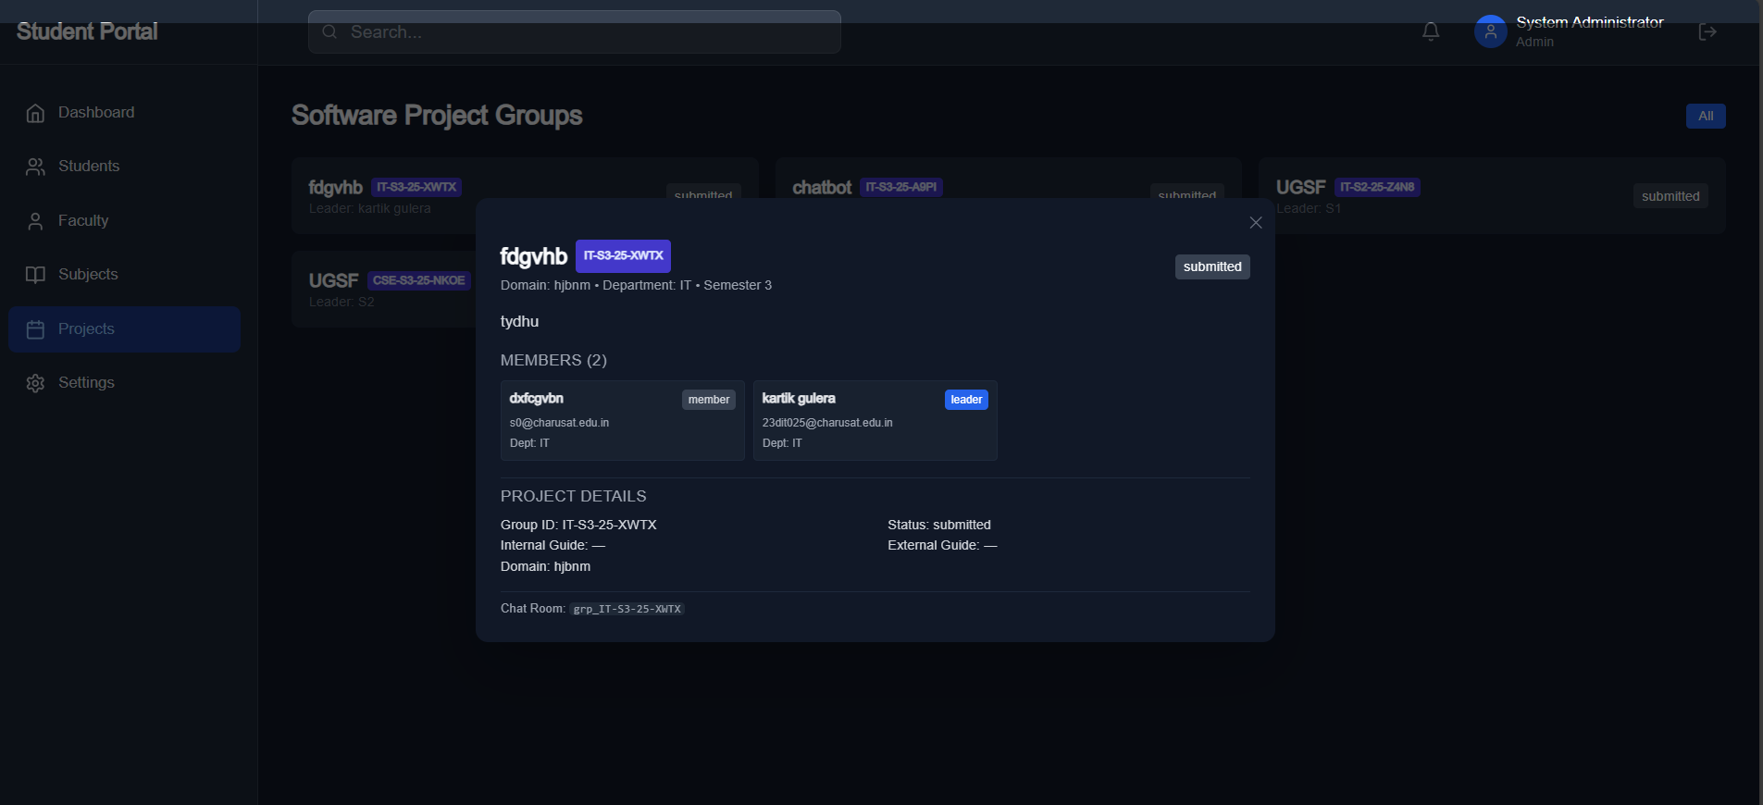
UI Screenshots
PROJECT PAGE FOR ADMIN ROLE
Each interface was designed with consistency, usability, and responsive behavior as primary considerations

Slide 11

Challenges & Solutions
1
Responsive Design Complexity
Implemented a custom grid system with breakpoints to maintain UI integrity across devices, testing extensively on various screen sizes
2
Frontend-Backend Coordination
Created detailed API contracts with teammate early in development, used mock data for UI development before integration
3
Next.js Routing Complexity
Invested time learning Next.js documentation thoroughly, implementing nested dynamic routes for project-specific pages

Slide 12
Next Steps in Development
With the UI design foundation established, we're now focusing on bringing the platform to life:
Backend Integration
Database Implementation
Connect all UI components to the API endpoints developed by my teammate, replacing mock data with real database interactions
Link form submissions directly to MongoDB collections, establish data validation rules, and optimize query performance
Testing & Refinement
Deployment
Conduct comprehensive user testing with students and faculty, identify usability issues, and implement improvements
Set up CI/CD pipeline for automated testing, deploy the application to Vercel for frontend and AWS for backend services
Our goal is to have a fully functional prototype ready for department-wide testing within the next two weeks.

Slide 13

Conclusion & Learnings
Key Accomplishments
Successfully designed all post-login UI screens through the project creation phase
Established a consistent, user-friendly interface design system
Created responsive layouts that work across devices
Developed reusable components for future expansion
Valuable Takeaways
Gained practical experience with Next.js in a real-world application
Developed deeper understanding of frontend-backend workflows
Learned the importance of early planning for complex interfaces
Ready to tackle the integration and deployment phases with confidence

